Slide 1


Mansoura University Faculty of Computers and Information Second Semester- 2020-2021
Computer Graphics
Grade: 2nd Year (General –BIO)
Prepared by: Dr. Haitham El-Ghareeb,
Dr.-Waleed Mohamed, Dr.-Ibrahim El-Hasnony

Slide 2
Scan Conversion

Slide 3
Scan conversion
Many pictures, from 2D drawings to projected views of 3D objects, consist of graphical primitives such as points, lines, circles, filled polygons, etc.
A line is defined by its two endpoints and the line equation. A circle is defined by its radius, center position, and circle equation.
It is the responsibility of the graphics system or the application program to convert each primitive from its geometric definition into a set of pixels that make up the primitives in the image space.
Most device that are used to produce images are raster devices, that is, use rectangular arrays of dots (pixels) to display the image.
Scan conversion or rasterization is the process of converting the primitives from its geometric definition into a set of pixels that make the primitive in image space.

Slide 4
Scan conversion
Scan conversion: is a process of representing graphics objects as a collection of pixels. The graphics objects are continuous. The pixels used are discrete. Each pixel can have either on or off state.
The circuitry of the video display device of the computer is capable of converting binary values (0, 1) into a pixel on and pixel off information. 0 is represented by pixel off. 1 is represented using pixel on. Using this ability, graphics computers represent pictures having discrete dots.
Any model of graphics can be reproduced with a dense matrix of dots or points. Most human beings think of graphics objects as points, lines, circles, ellipses. For generating graphical objects, many algorithms have been developed.
Advantage of developing algorithms for scan conversion
Algorithms can generate graphics objects at a faster rate.
Using algorithms memory can be used efficiently.
Algorithms can develop a higher level of graphical objects.

Slide 5
The objective of this chapter
To understand the basic idea of different scan conversion algorithms.
To learn point, line, circle ellipse, arc, and polygon scan conversion algorithms.

Slide 6
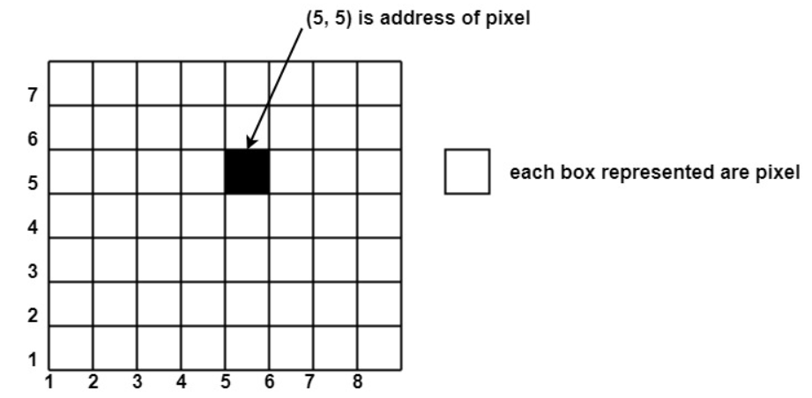
Pixel representation
Pixels are also defined as the smallest addressable unit or element of the screen. Each pixel can be assigned an address as shown in fig:

Slide 7
Pixel representation
Different graphics objects can be generated by setting the different intensity of pixels and different colours of pixels. Each pixel has some co-ordinate value. The coordinate is represented using row and column.
P (5, 5) used to represent a pixel in the 5th row and the 5th column. Each pixel has some intensity value which is represented in the memory of a computer called a frame buffer. Frame Buffer is also called a refresh buffer. This memory is a storage area for storing pixels’ values using which pictures are displayed. It is also called digital memory.
Inside the buffer, the image is stored as a pattern of binary digits either 0 or 1. So there is an array of 0 or 1 used to represent the picture. In black and white monitors, black pixels are represented using 1's and white pixels are represented using 0's. In case of systems having one bit per pixel frame buffer is called a bitmap. In systems with multiple bits per pixel it is called a pixmap.

Slide 8
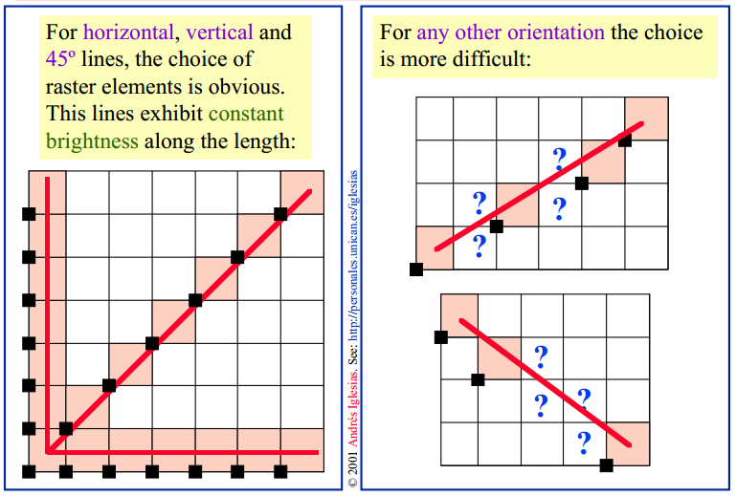
Pixel representation

Slide 9
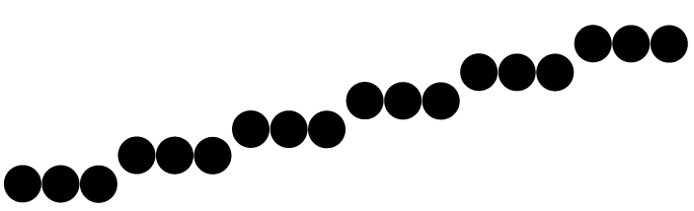
Pixel representation
Screen locations are referenced with integer values, so plotted positions may only approximate actual line positions between two specified endpoints. For example, line position of (12.36, 23.87) would be converted to pixel position (12, 24). This rounding of coordinate values to integers causes lines to be displayed with a stair step appearance (“the jaggies”), as represented in fig.

Slide 10
Scan converting a point
A mathematical point (x, y) where x and y are real numbers within an image area needs to be scan-converted to pixel at location (x',y').
This may be done by making x' to be the integer part of x, and y' the integer part of y.
In other words, x' = Floor(x) and y' = Floor(y), function Floor returns the largest integer that is less than or equal to the argument.
All points that satisfy x' <= x < x' + 1 and y' <= y < y' + 1 are mapped to pixel (x' ,y').

Slide 11
Scan converting a point
A For example, point P₁ (1.7, 0.8) is represented by pixel (1,0). Point P₂ (2.2, 1.3) and P₃(2.8, 1.9) are both represented by pixel (2,1).
Another approach is to align the integer values in the coordinate system for (x, y) by making x' = Floor(x+0.5) and y' = Floor(y+0.5).
All points that satisfy x' - 0.5 <=x< x' + 0.5 and y' - 0.5 <=y< y' + 0.5 are mapped to pixel (x', y').

Slide 12
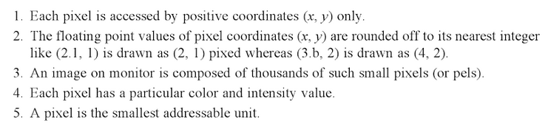
Scan converting a point

Slide 13
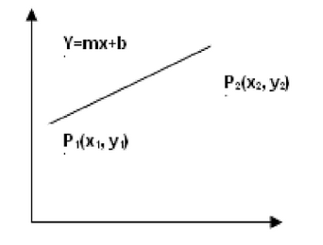
Scan converting a line
A line is defined by its two endpoints and the line equation y = mx + b, where m is called the slope and b the y intercept of the line.
Slope = m = dy/dx = (y2 - y1) / (x2 - x1)

Slide 14
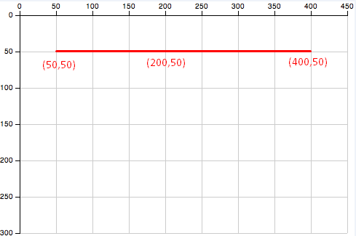
Scan converting a line
Horizontal Line:
Draw pixel P and increment x coordinate value by 1 to get the next pixel.

Slide 15
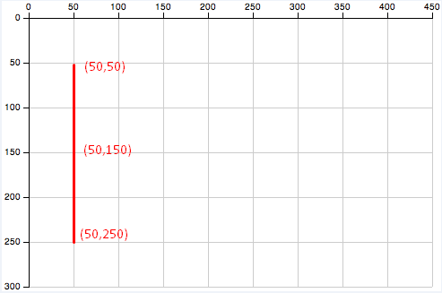
Scan converting a line
Vertical Line:
Draw pixel P and increment y coordinate value by 1 to get the next pixel.

Slide 16
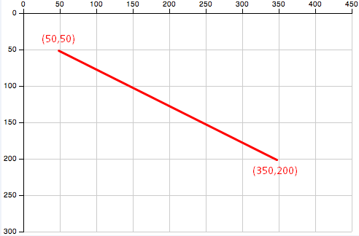
Scan converting a line
diagonal Line:
Draw pixel P and increment both x and y coordinate by 1 to get the next pixel.

Slide 17
Scan converting a line
To scan a line, we have two methods:
Direct use of the line equation
DDA algorithm
Bresenham's Algorithm

Slide 18
Slope intersect equation algorithm
Scan-convert P₁ and P₂ to pixel coordinates (x₁',y₁'), and (x₂' ,y₂') respectively.
Calculate m and b
Set m = (y₂' -y₁')/ (x₂'-x₁') and b = y₁' - mx₁'.
Check the value of m
If |m| < =1, for every integer value of x between and excluding x₁' and x₂', calculate the corresponding value of y using the equation and scan-convert (x, y).
If |m| >1, for every integer value of y between and excluding y₁' and y₂', calculate the corresponding value of x using the equation and scan-convert (x, y).

Slide 19
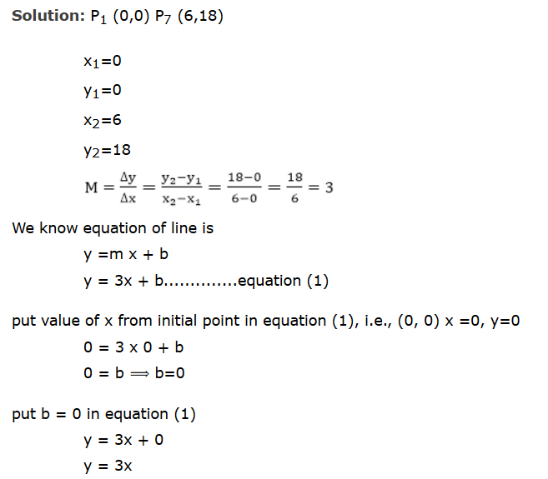
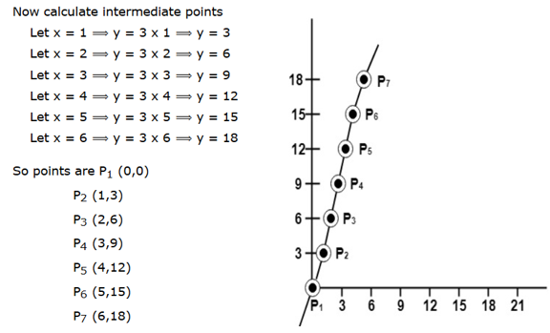
Slope intersect equation algorithm
Example: A line with starting point as (0, 0) and ending point (6, 18) is given. Calculate value of intermediate points and slope of line.

Slide 20
Dda algorithm
The digital differential analyzer (DDA) algorithm is an incremental scan-conversion method.
It is characterized by performing calculations at each step using results from the preceding step.
DDA is simply a scan conversion line drawing algorithm based on the parameters ∆x and ∆y.

Slide 21
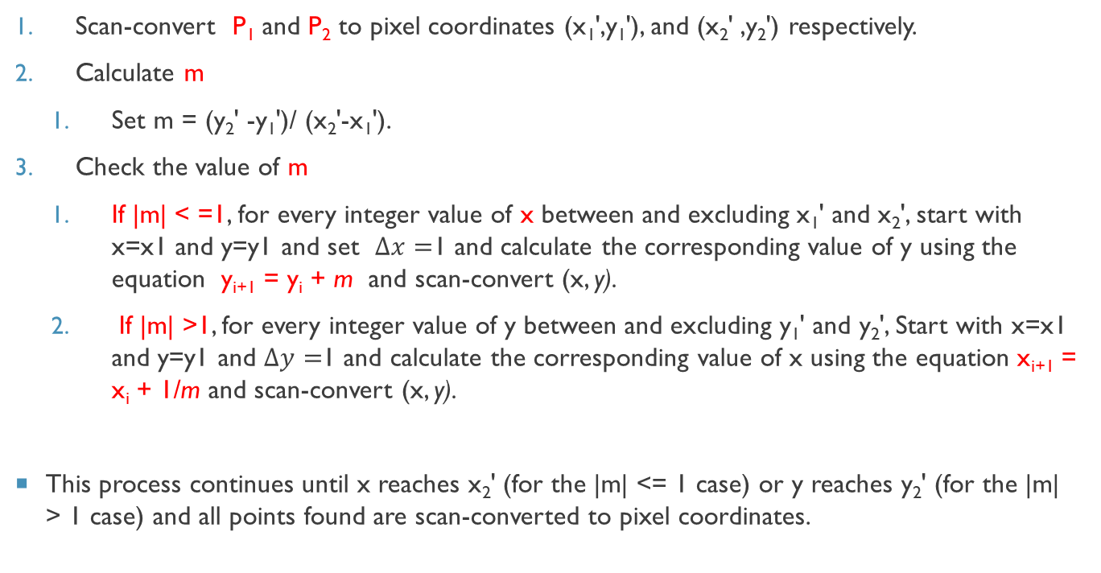
Dda algorithm
Scan-convert P₁ and P₂ to pixel coordinates (x₁',y₁'), and (x₂' ,y₂') respectively.
Calculate m
Set m = (y₂' -y₁')/ (x₂'-x₁').
Check the value of m
If |m| < =1, for every integer value of x between and excluding x₁' and x₂', start with x=x1 and y=y1 and set $∆x=$1 and calculate the corresponding value of y using the equation y_{i+1} = y_{i} + m and scan-convert (x, y).
If |m| >1, for every integer value of y between and excluding y₁' and y₂', Start with x=x1 and y=y1 and $∆y=$1 and calculate the corresponding value of x using the equation x_{i+1} = x_{i} + 1/m and scan-convert (x, y).
This process continues until x reaches x₂' (for the |m| <= 1 case) or y reaches y₂' (for the |m| > 1 case) and all points found are scan-converted to pixel coordinates.

Slide 22
Dda example
Find pixels Coordinates in order to draw the line between starting point (0,1) and ending point (5,4) using DDA
Solution
slope m=dy/dx
dy=4-1=3
dx=5-0=5
m= 3/5 so |m| <1
y_{i+1}= y_{i}+m
and always increment x by 1,the following table shows the result.

Slide 23
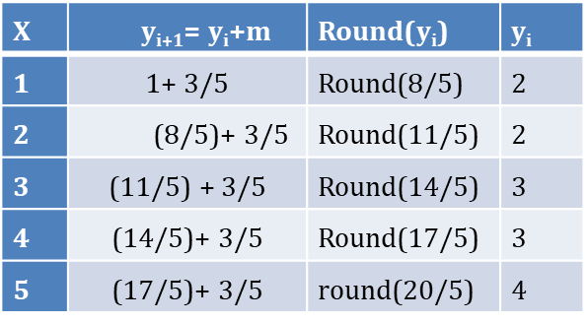
Dda example

Slide 24
Dda algorithm
The DDA algorithm is faster than the slope-intercept line equation since it calculates points on the line without any floating-point multiplication. However, a floating-point addition is still needed in determining each successive point.
Advantages:
It is a faster algorithm.
It is a simple algorithm.
Require no special skills for implementation.
Disadvantages:
Floating point arithmetic is time consuming.
Poor endpoint accuracy

Slide 25
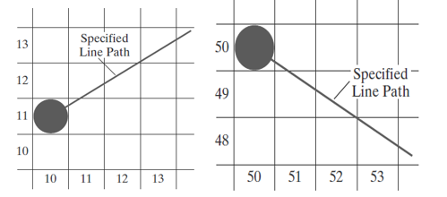
Bresenham’s Line Algorithm
An accurate and efficient raster line-generating algorithm, developed by Bresenham, that uses only incremental integer calculations. In addition, Bresenham’s line algorithm can be adapted to display circles and other curves
We need to decide which of two possible pixel positions is closer to the line path at each sample step. Starting from the left endpoint shown in the first figure, we need to determine at the next sample position whether to plot the pixel at position (11, 11) or the one at (11, 12). Similarly, the second figure shows a negative-slope line path starting from the left endpoint at pixel position (50, 50). In this one, do we select the next pixel position as (51, 50) or as (51, 49)?

Slide 26
Bresenham’s Line Algorithm
Let’s see Bresenham’s line drawing algorithm for |m| < 1
1. Input the two line endpoints and store the left endpoint in (x₀, y₀).
2. Load (x₀, y₀) into the frame buffer; that is, plot the first point.
3. Calculate constants Δx, Δy, 2Δy, and 2Δy − 2Δx, and obtain the starting value for the decision parameter as
p₀ = 2Δy − Δx
4. At each x_{k} along the line, starting at k = 0, perform the following test:
If p_{k} < 0, the next point to plot is (x_{k + 1}, y_{k}) and
𝑝_{𝑘+1} = 𝑝_{𝑘} + 2Δ𝑦
Otherwise, the next point to plot is (x_{k} + 1, y_{k} + 1) and
𝑝_{𝑘+1} = 𝑝_{𝑘} + 2Δ𝑦 − 2Δ𝑥
5. Repeat step-4 Δx times.

Slide 27
Bresenham’s Line Algorithm
For a line with positive slope greater than 1.0, we interchange the roles of the x and y directions. That is, we step along the y direction in unit steps and calculate successive x values nearest the line path. Also, we could revise the program to plot pixels starting from either endpoint. If the initial position for a line with positive slope is the right endpoint, both x and y decrease as we step from right to left.

Slide 28
Bresenham’s Line Algorithm
Example
Digitize the line with endpoints (20, 10) and (30, 18).
This line has a slope of 0.8, with Δx = 10, Δy = 8
The initial decision parameter has the value
p₀ = 2Δy − Δx=6
and the increments for calculating successive decision parameters are
2Δy = 16, 2Δy − 2Δx = −4
We plot the initial point (x₀, y₀) = (20, 10), and determine successive pixel positions along the line path from the decision parameter as follows

Slide 29
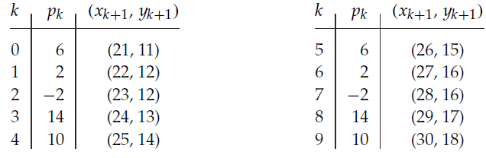
Bresenham’s Line Algorithm

Slide 30
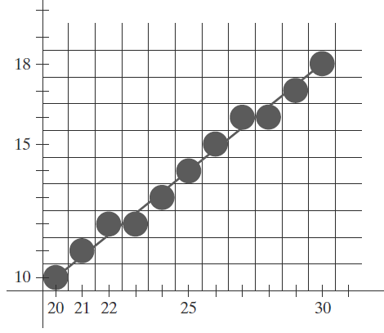
Bresenham’s Line Algorithm
A plot of the pixels generated along this line path is shown

Slide 31
Bresenham’s Line Algorithm
The advantages of Bresenham Line Drawing Algorithm are-
It is easy to implement.
It is fast and incremental.
It executes fast but less faster than DDA Algorithm.
The points generated by this algorithm are more accurate than the DDA Algorithm.
It uses fixed points only.
The disadvantages of Bresenham Line Drawing Algorithm are-
Though it improves the accuracy of generated points but still the resulting line is not smooth.
It can not handle diminishing jaggies.

Slide 32
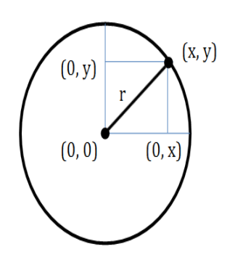
Scan converting a circle
To draw a circle we need two things, the coordinates of the center and the radius of the circle.
The radius of a circle is the length of the line from the center to any point on its edge.
For any point on the circle (x,y) and the center at point (x_{c},y_{c}), the equation of the circle is
(x-x_{c})²+ (y-y_{c}) ²- r² = 0
Here r is the radius of the circle. If the circle has origin (0,0) as its center then the above equation can be reduced to
x² + y² = r²

Slide 33
Scan converting a circle
A circle is a symmetrical figure.
Any circle-generating algorithm can take advantage of the circle's symmetry to plot eight points for each value that the algorithm calculates.
Eight-way symmetry is used by reflecting each calculated point around each 45 axis.
If point were calculated with a circle algorithm, seven more points could be found by reflection.
The reflection is accomplished by reversing the x, y coordinates.

Slide 34
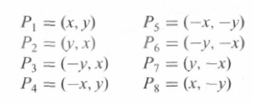
Scan converting a circle
(-x, y)
(x, y)
(-y, x)
(y, x)
(-y, -x)
(y, -x)
(-x, -y)
(x, -y)

Slide 35
Scan converting a circle
There are two standard methods of mathematically defining a circle centered at the origin.
Polynomial method
Trigonometric method
Midpoint circle algorithm

Slide 36
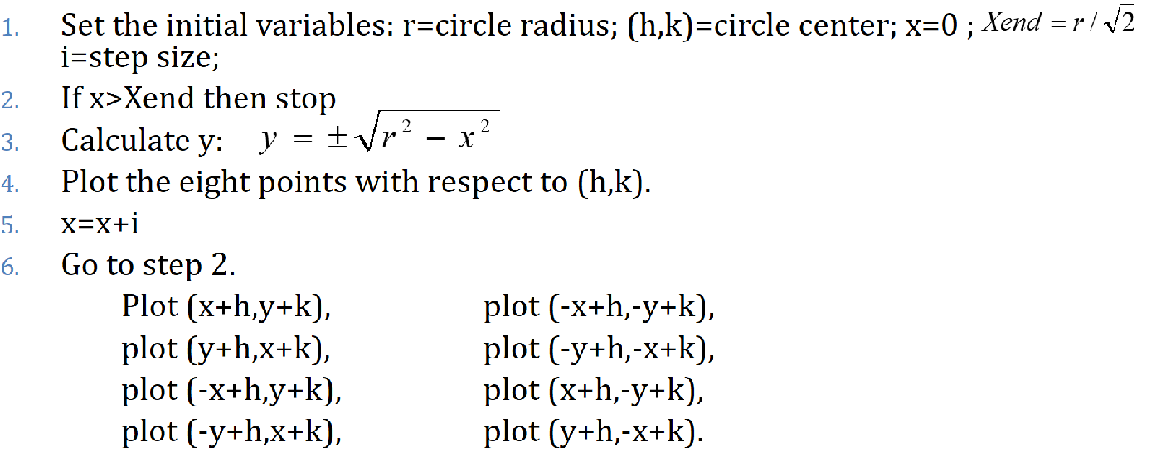
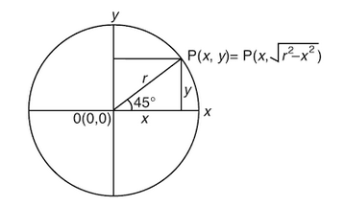
Polynomial method
Advantages:
Easy to understand
Fair to implement
Disadvantages:
Consume time for calculations square root and square
Assume that there is a circle with its centre at origin (0, 0). Let the coordinates of a point on the circle and r be its radius

Slide 37
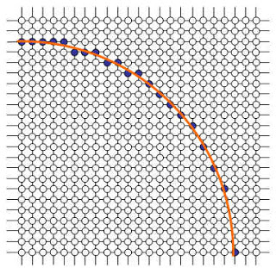
A Simple Circle Drawing Algorithm (cont…)

Slide 38

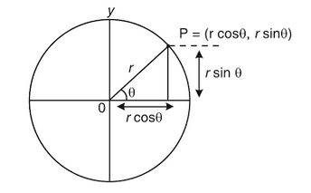
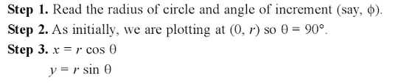
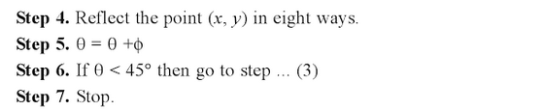

Trigonometric method
From the shape:
where (x_{c},y_{c}) are the center position
This method scan converts a circle by stepping $θ$ from 0 to $π/4$ and then calculating each value of x and y.

Slide 39

Midpoint circle algorithm
we sample at unit intervals and determine the closest pixel position to the specified circle path at each step.
For a given radius r and screen center position (x_{c} , y_{c} ), we can first set up our algorithm to calculate pixel positions around a circle path centered at the coordinate origin (0, 0). Then each calculated position (x, y) is moved to its proper screen position by adding x_{c} to x and y_{c} to y.
Along the circle section from x = 0 to x = y in the first quadrant, the slope of the curve varies from 0 to −1.0.
Therefore, we can take unit steps in the positive x direction over this octant and use a decision parameter to determine which of the two possible pixel positions in any column is vertically closer to the circle path.
Positions in the other seven octants are then obtained by symmetry. To apply the midpoint method, we define a circle function as

Slide 40
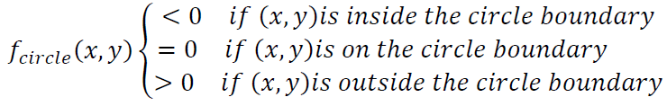
Midpoint circle algorithm
Any point (x, y) on the boundary of the circle with radius r satisfies the equation f_{circ} (x, y) = 0. If the point is in the interior of the circle, the circle function is negative; and if the point is outside the circle, the circle function is positive. To summarize, the relative position of any point (x, y) can be determined by checking the sign of the circle function as follows:
In the above equation, we calculate for the mid positions between pixels near the circular path at each sampling step and we set up incremental calculation for this function as we did in the line algorithm. Below figure shows the midpoint between the two candidate pixels at sampling position 𝑥_{𝑘 + 1.}

Slide 41
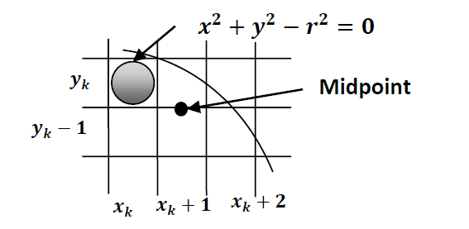
Midpoint circle algorithm
Assuming we have just plotted the pixel at (𝑥_{𝑘}, 𝑦_{𝑘}) and next we need to determine whether the pixel at position (𝑥_{𝑘 + 1}, 𝑦_{𝑘}) or the one at position) 𝑥_{𝑘 + 1}, 𝑦_{𝑘 − 1}) is closer to circle boundary.

Slide 42
Midpoint circle algorithm
Algorithm for Midpoint Circle Generation
1. Input radius r and circle center (𝑥_{𝑐}, 𝑦_{𝑐}) and obtain the first point on the circumference of a circle centred on the origin as
(𝑥₀, 𝑦₀) = (0, 𝑟)
2. calculate the initial value of the decision parameter as
𝑝₀ = 5/4 − 𝑟
3. At each x_{k} position, starting at k = 0, perform the following test:
If p_{x} < 0, the next point along the circle centered on (0, 0) is (𝑥_{𝑘 + 1}, 𝑦_{𝑘}) &
𝑝_{𝑘+1} = 𝑝_{𝑘} + 2𝑥_{𝑘+1} + 1
Otherwise, the next point along the circle is (𝑥_{𝑘 + 1}, 𝑦_{𝑘 − 1}) &
𝑝_{𝑘+1} = 𝑝_{𝑘} + 2𝑥_{𝑘+1} + 1 − 2𝑦_{𝑘+1}
Where 2𝑥_{𝑘+1} = 2𝑥_{𝑘} + 2, & 2𝑦_{𝑘+1} = 2𝑦_{𝑘} − 2
4. Determine symmetry points in the other seven octants.
5. Move each calculated pixel position (x, y) onto the circular path centered on (𝑥_{𝑐}, 𝑦_{𝑐}) and plot the coordinate values:
𝑥 = 𝑥 + 𝑥_{𝑐}, 𝑦 = 𝑦 + 𝑦_{𝑐}
6. Repeat steps 3 through 5 until 𝑥 ≥ 𝑦.

Slide 43
Midpoint circle algorithm
Example:
Given a circle radius r = 10, we demonstrate the midpoint circle algorithm by determining positions along the circle octant in the first quadrant from x = 0 to x = y. The initial value of the decision parameter is
p₀ = 1 − r = −9
For the circle cantered on the coordinate origin, the initial point is (x₀, y₀) = (0,10), and initial increment terms for calculating the decision parameters are
2x₀ = 0, 2y₀ = 20
Successive midpoint decision parameter values and the corresponding coordinate positions along the circle path are listed in the following table:

Slide 44
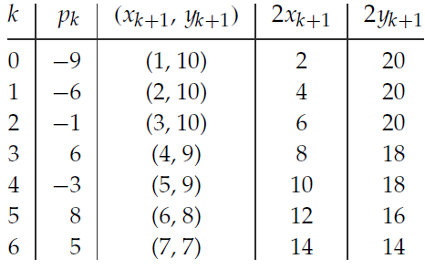
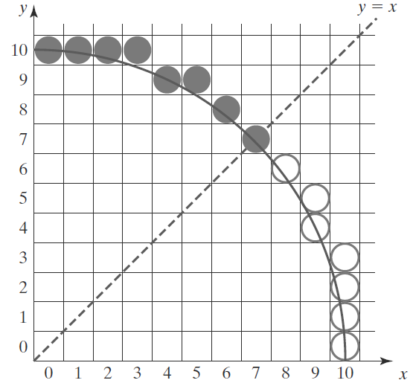
Midpoint circle algorithm

Slide 45
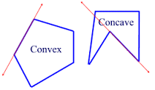
Polygons

Slide 46
Polygons
Convex polygons are the simplest type of polygon to fill. Lines connecting any two points on the boundary of the polygon are still inside the polygon.
Concave polygons are a superset of convex polygons, having fewer restrictions than convex polygons. Lines connecting any two points on the boundary of the polygon may crosses outside the polygon.

Slide 47
Scan converting a polygon
A polygon scan conversion is the process of converting a polygon edge into data which can be used by the polygon filling routine. The process is essentially a single case of the line drawing algorithm.
A polygon edge is calculated as if it were a line, but the line is not drawn to the screen. Instead the information is saved in a buffer for use later.

Slide 48
Rectangle algorithm
Set the initial variables: (x1,y1)= upper left corner, (x2,y2)= lower right corner
Plot line from (x1,y1) to (x2,y1)
Plot line from (x1,y1) to (x1,y2)
Plot line from (x2,y1) to (x2,y2)
Plot line from (x1,y2) to (x2,y2)

Slide 49
Curves
Usefulness of curves in Computer Graphics.
Modeling
Animation
Fonts

Slide 50
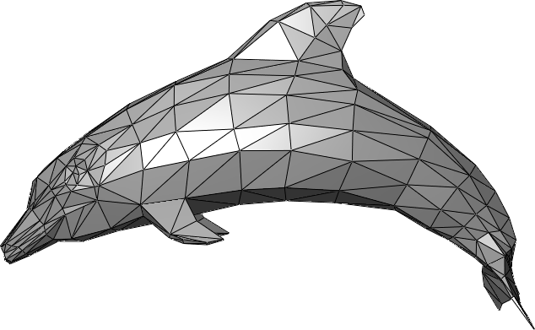
Usefulness of curves in modeling

Slide 51
Usefulness of curves in animation
Provide a “track” for objects

Slide 52
Usefulness of curves in Fonts
Curve are widely used (Adobe, Microsoft) for font definition

Slide 53
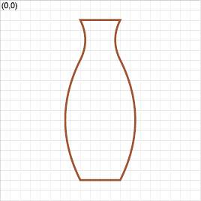
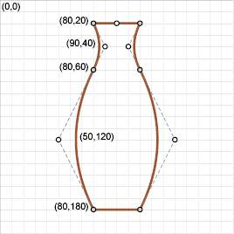
How to represent curves?
Specify every point along a curve?
Used sometimes as “freehand drawing mode” in 2D applications
Hard to get exact results
Specify a curve using a small number of “control points”

Slide 54
What is a curve, anyway?
Mathematically we treat it as a function, x(t)
Given a value of t, computes a point x
Can think of the function as moving a point along the curve
x(t)
z
y
y
x(0.0)
x(0.5)
x(1.0)
x

Slide 55
Types of Curve Curves
Linear:
(1st order)
Quadratic:
(2nd order)
Cubic:
(3rd order)
We usually define the curve for 0 ≤ t ≤ 1

Slide 56
How much do you need to specify Curve?
Two points define a line (1st order)
Three points define a quadratic curve (2nd order)
Four points define a cubic curve (3rd order)
k+1 points define a k-order curve

Slide 57
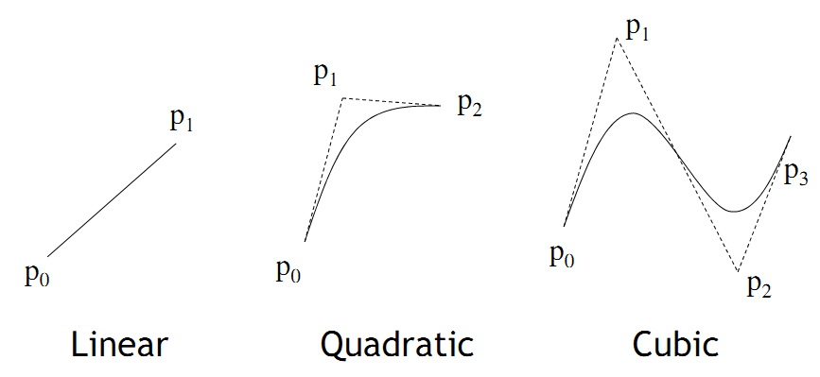
Curves

Slide 58
Control Point
A control point defines the curvature of your quadratic curve by creating two imaginary tangential lines which are connected to the context (starting )point and the ending point.
Special Case
If the starting point, control points and ending point are share the same X value or Y value , it is a linear curve (straight line)
For example Start point P0 , control point P1, control points P2 and ending point P3
P0 at (10,10), P1 at (20,10) P2 at (30,10) and P3 at (40,10)

Slide 59
Bezier curve
A Bezier curve is defined by the starting point, two control points, and an ending point.
A Bézier curve is completely specified by an ordered set of points, called its control points.
The first and last control points are the curve’s end points, where it starts and finishes. The entire curve will lie within the polygon constructed by joining the control points with straight lines.

Slide 60
Bezier curve
The line between the starting end point and the next control point is a tangent to the curve, and so is the line between the final end point and the preceding control point.
The first part of the curve is tangential to the imaginary line that is defined by the context point and the first control point.
The second part of the curve is tangential to the imaginary line that is defined by the second control point and the ending point.

Slide 61
Bezier curve

Slide 62
Thanks

